Slide 1
Making up names

Slide 2
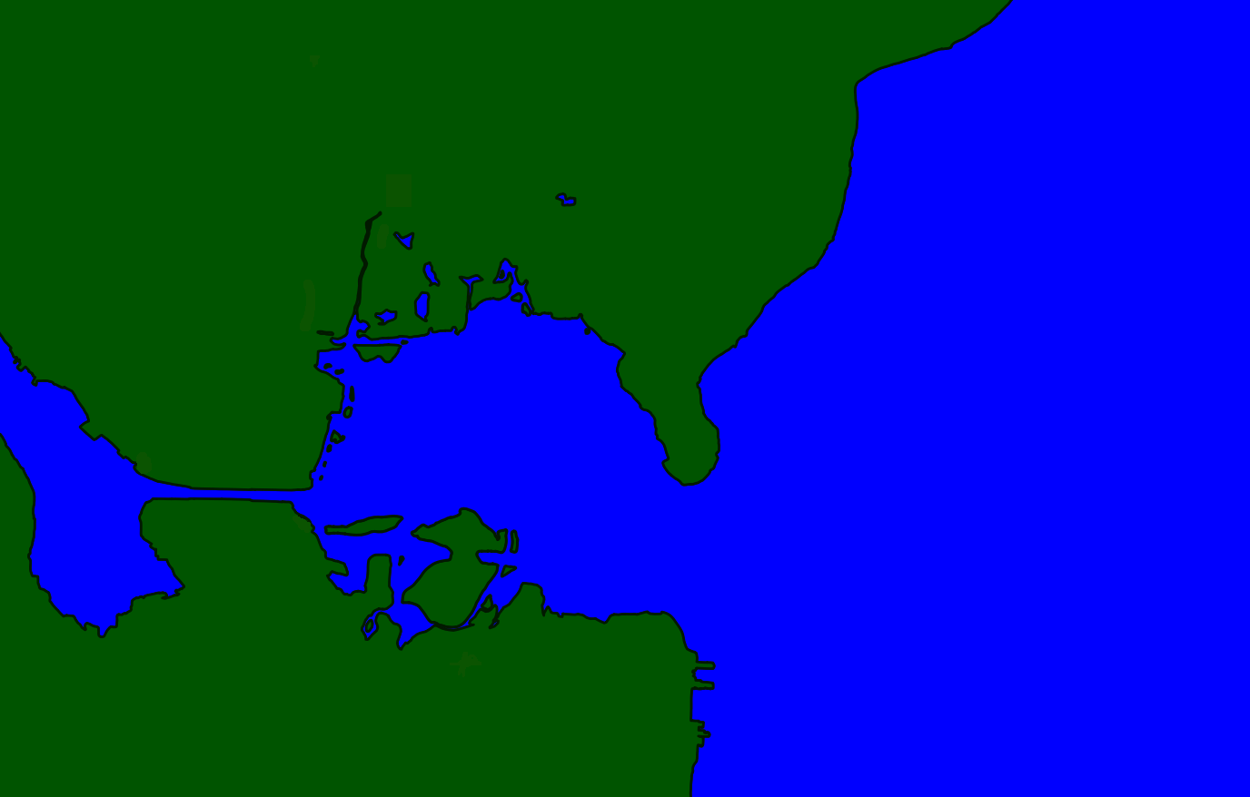
We are on native land
Notes:
I’d like to start with a reminder that we are on native land. Before this area was built up, it would have been foraging grounds for:
The Duwamish, “people of the inside”, to the South
The Hachooabsh, “lake people”, to the East
The Shilshoolabsh, “people of the tucked-away bay” to the West
I don’t know what this spot was called, but I was able to learn some nearby place names:

Slide 3
We are on native land
University Village was an actual village, on the lake shore:
shLoowééhL
“Little Canoe Hole”
The Montlake Cut used to be low land between the two lakes:
sxWátSadweehL
“Carry a Canoe”
shLoowééhL
sxWátSadweehL
Notes:
Native place names tended to be descriptive of either the appearance, a natural resource found there, or an activity people would do there.

Slide 4
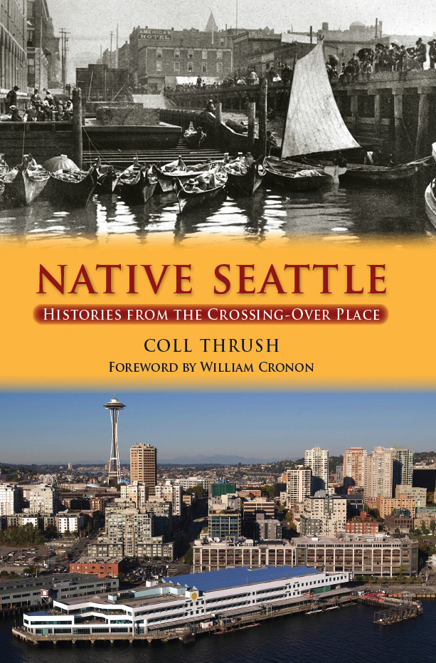
We are on native land
shLoowééhL
sxWátSadweehL
Notes:
If you want to learn more about the ongoing Native presence here, I strongly recommend this book:
https://www.washington.edu/uwpress/search/books/THRNA2.html

Slide 5
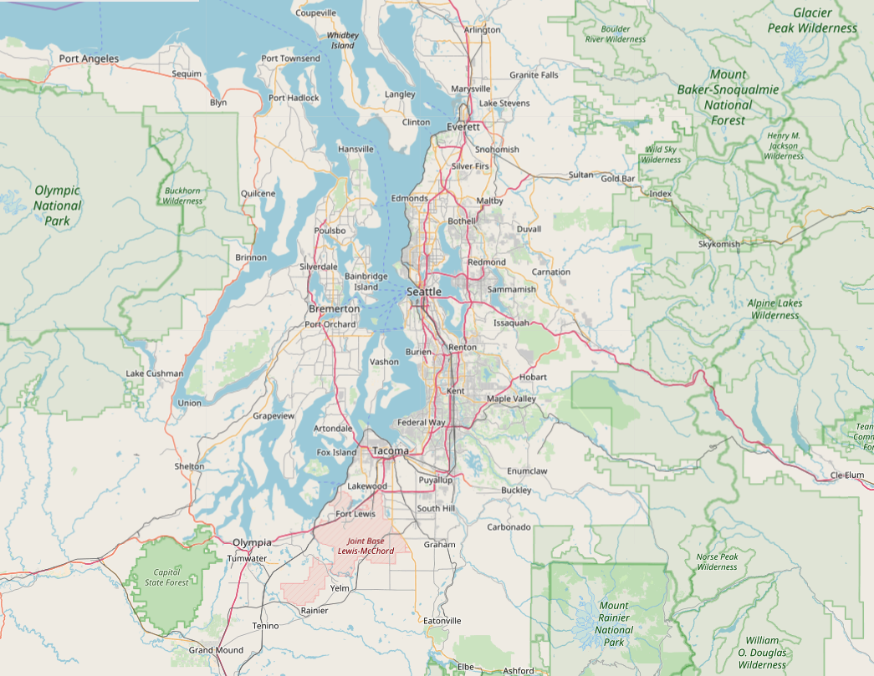
Settler place name themes
“Where we’re from” – Kent, Wallingford, etc.
“Some white guy” – Redmond, Kirkland, etc.
“Sales pitch” – Bellevue, Lake Forest Park, etc.
“Captain Vancouver’s expedition was miserable” – Mutiny Bay, Cape Disappointment, etc.
“Bastardised Native names” ...
Notes:
Settler place names just aren’t very good, are they? Here are what I think of as the main themes.
[after last reveal, play https://www.youtube.com/watch?v=oUMpPgMGCe8&feature=youtu.be&t=80 until the title credit shows

Slide 6
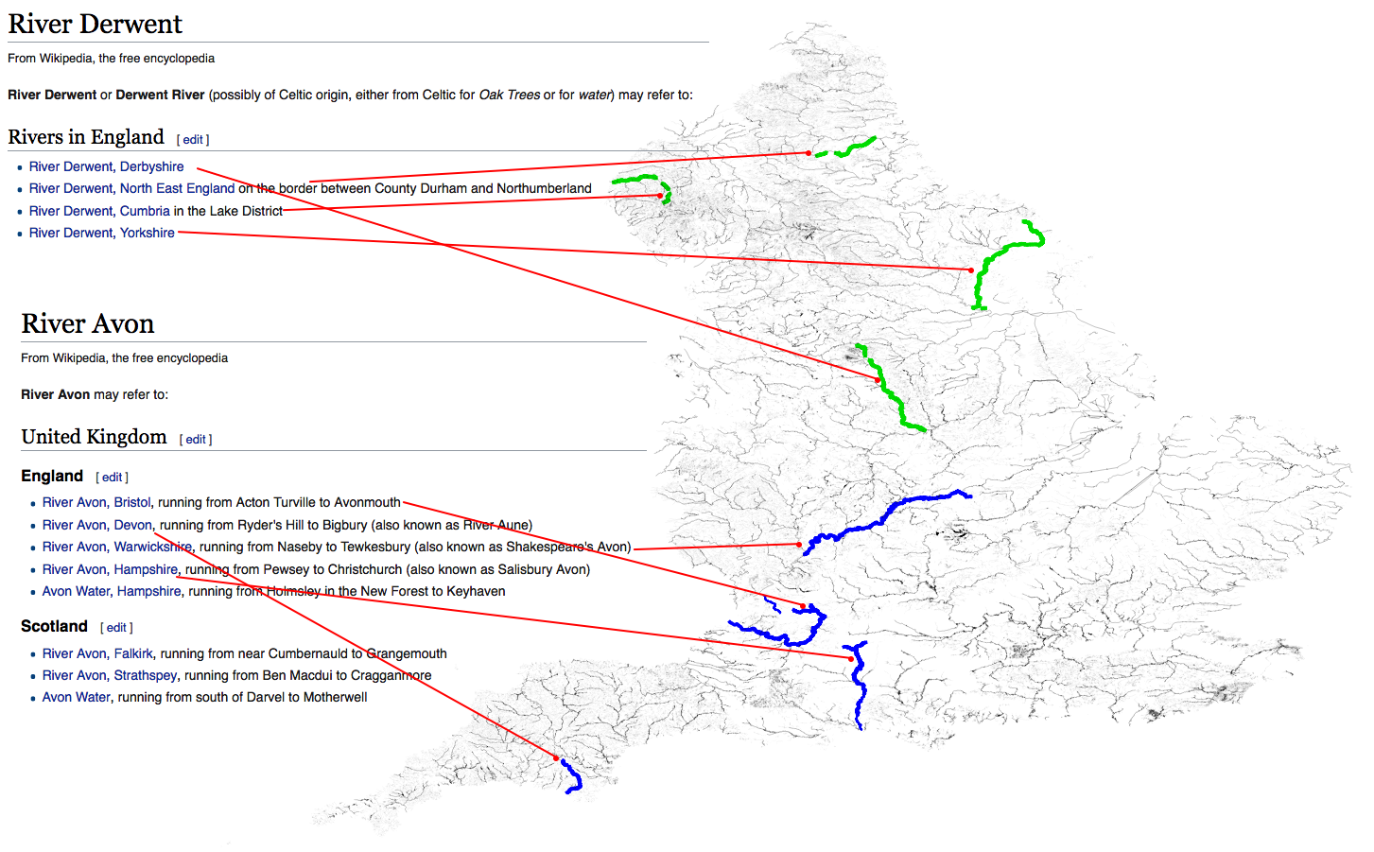
”Old World” place names
Notes:
Old World place names tend to be better, but it’s often obscured by the succession of languages. For example Britain, where I grew up, was successively invaded by Celts, Romans, Anglo-Saxons, Vikings and Normans, and all of their languages have ended up jumbled up in place names. Sometimes that BabaKiueria phenomenon must have happened, which is how England has 5 “River Rivers” and 4 “Water Rivers”. But it’s more often just that the sound of a name has become unrecognisable over generations. And that’s how we ended up with names like...

Slide 7
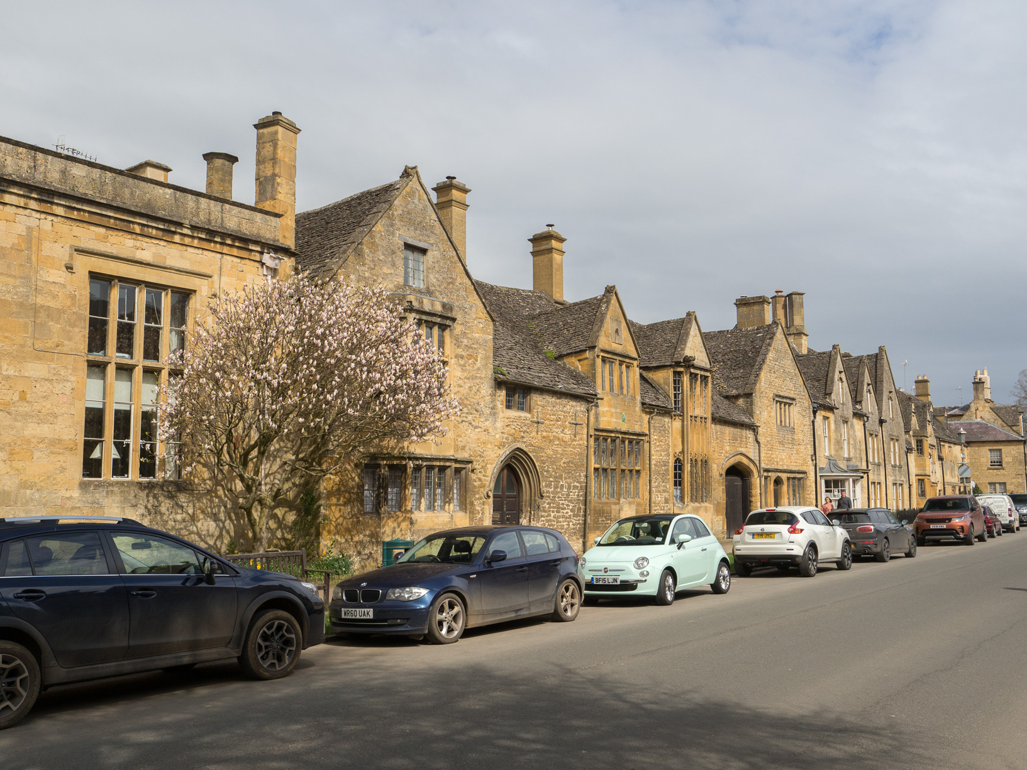
Chipping Campden

Slide 8
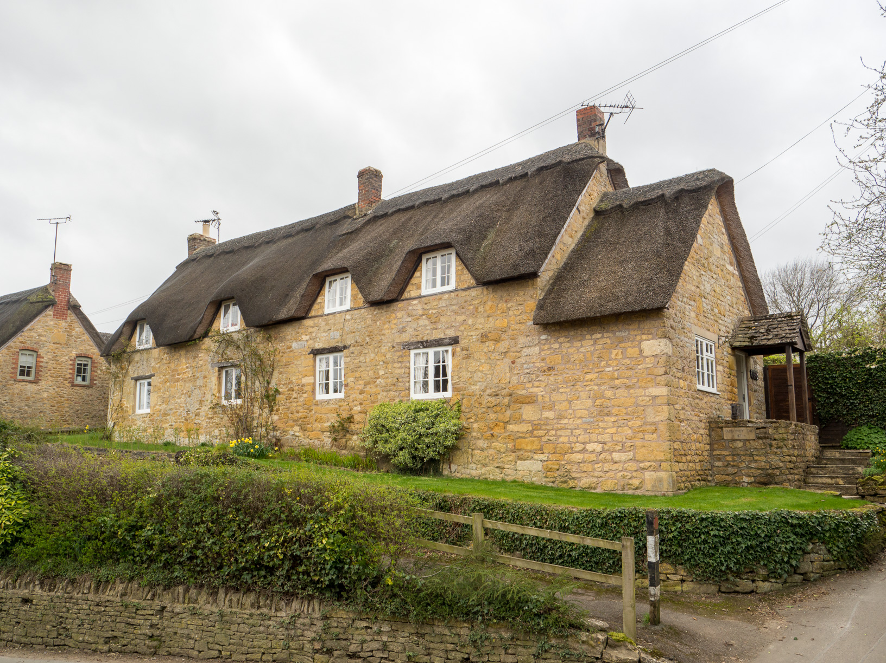
Ebrington

Slide 9
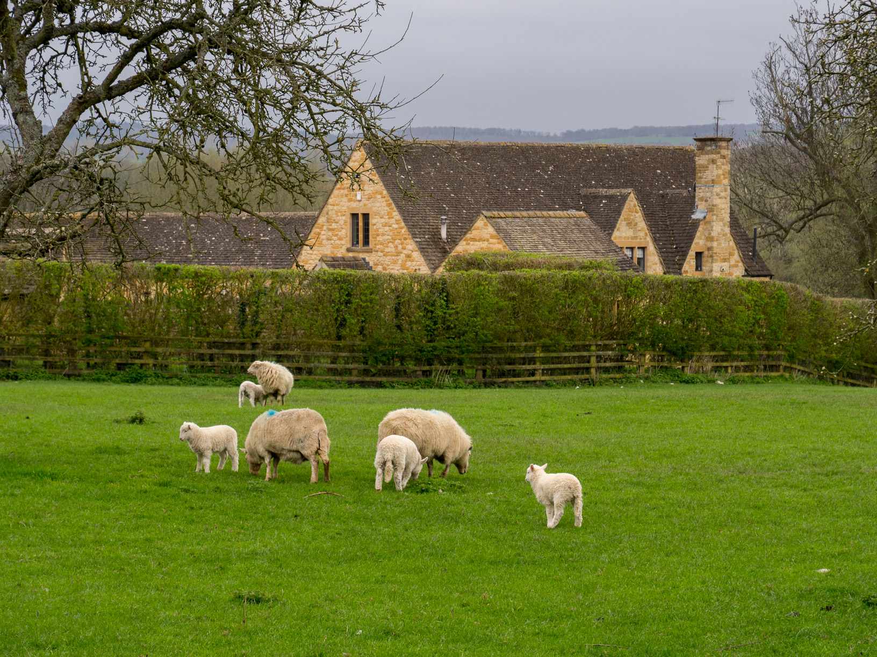
Paxford

Slide 10
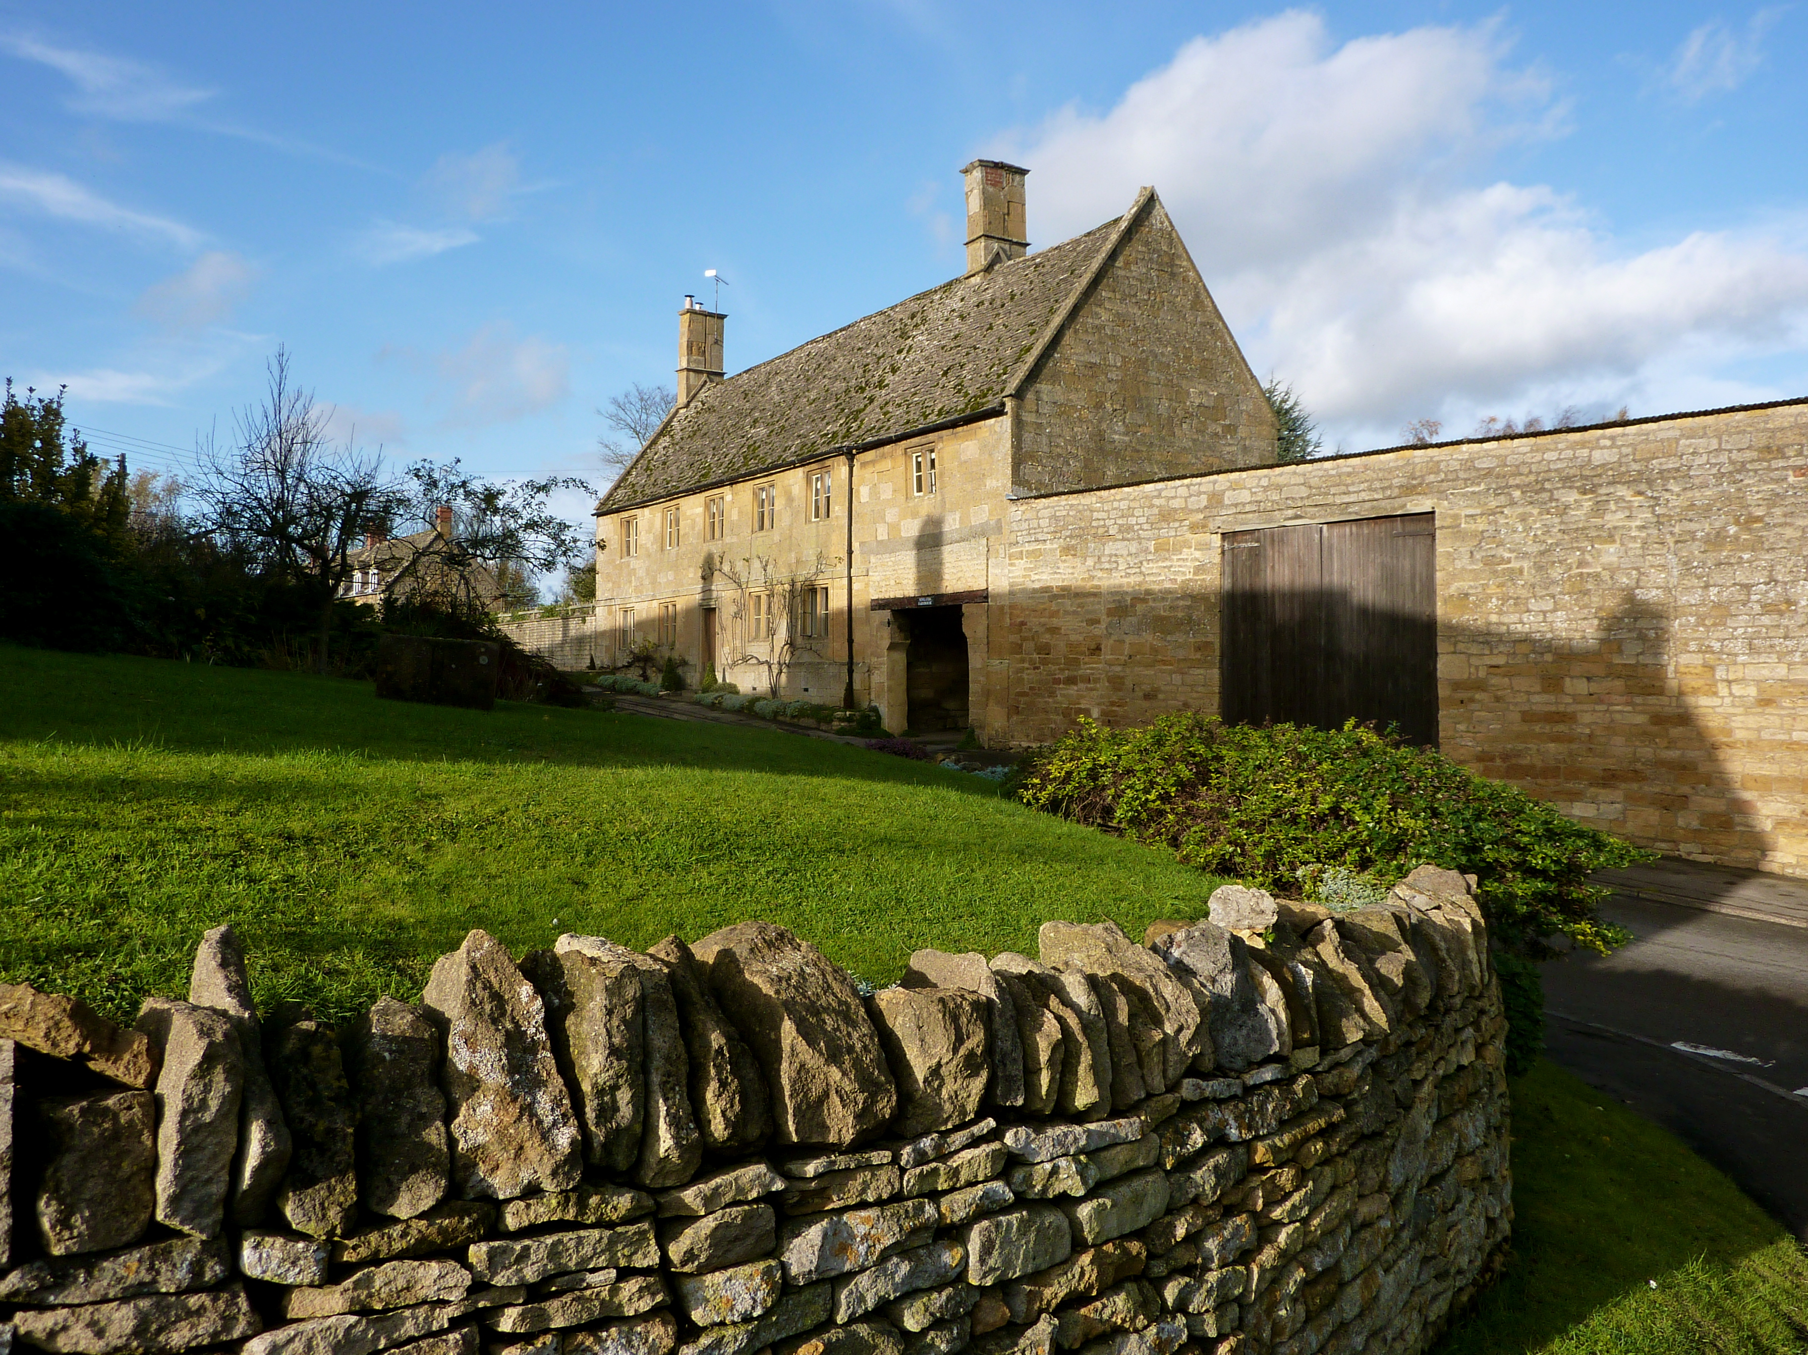
Aston Magna
Photo by Christian Guthier

Slide 11
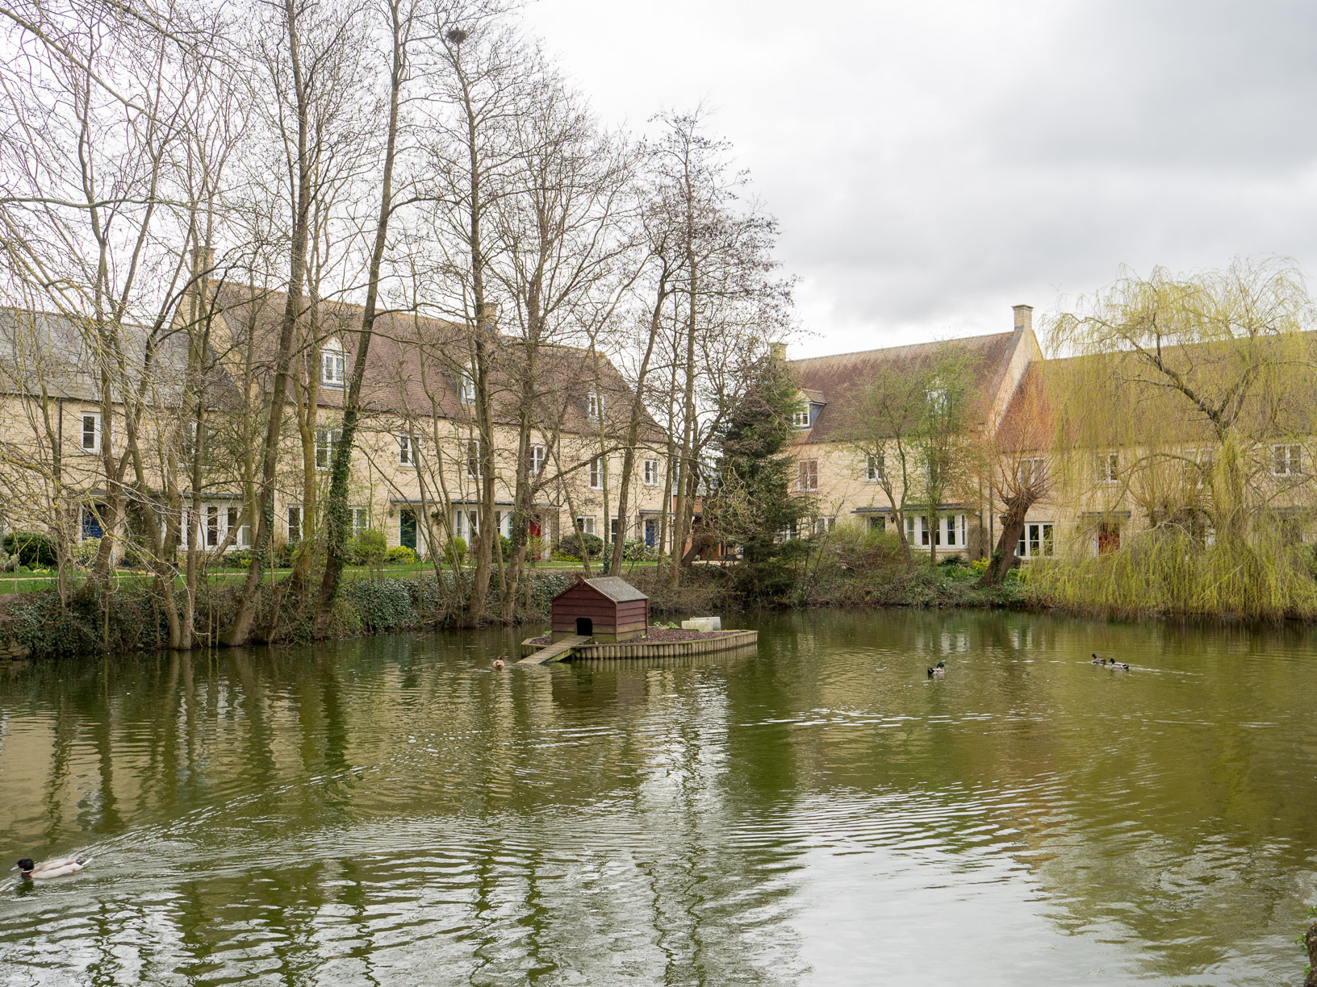
Moreton -in- Marsh
Notes:
These aren’t selected at random, or for their weirdness. They’re just the villages we walked through in one day hike in April.

Slide 12
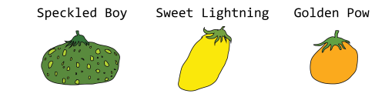
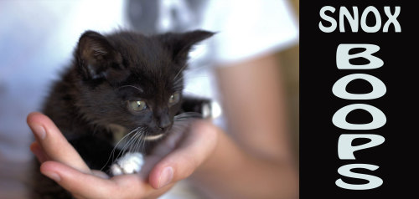
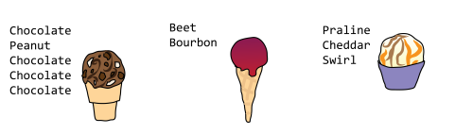
Clearly, this needs a neural network
Janelle Shane uses neural networks to generate names based on existing themes, and shares them at http://aiweirdness.com/
Notes:
On that hike, I found myself thinking about Janelle Shane’s “Letting neural networks be weird” site. She uses RNNs to generate names for things like:
Tomatoes, ice cream, kittens

Slide 13
Method
Use http://aiweirdness.com/faq to get started
Install https://github.com/minimaxir/textgenrnn
Get place names from OpenStreetMap
Group them by region
Train once on the whole set
Then train repeatedly on a region, and generate new names

Slide 14
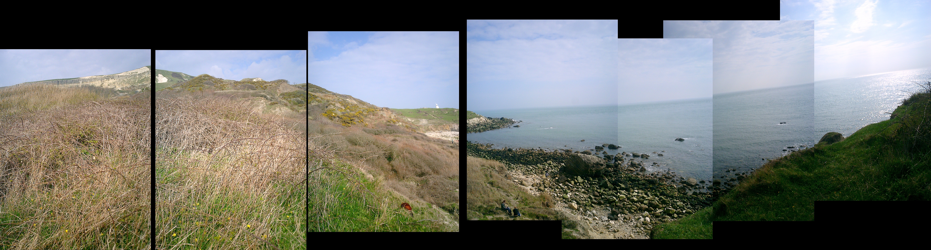
Known issue: the Isle of Wight
Photo by Danny Hope
Notes:
This is the Isle of Wight. It’s lovely and underappreciated by tourists. You should visit. It also has a distinctive dialect that shows up in place names and ought to make an interesting test for this project, but for some reason it makes my script hang. I have no idea why.

Slide 15
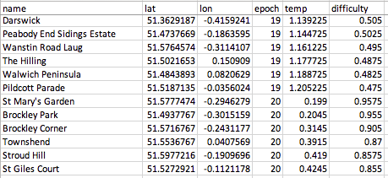
Output, the boring way
Notes:
Lat & lon were not generated in any clever way. I just had input files with three columns—name,latitude,longitude—and let the neural network copy the pattern with no insight. It worked better than I expected.

Slide 16
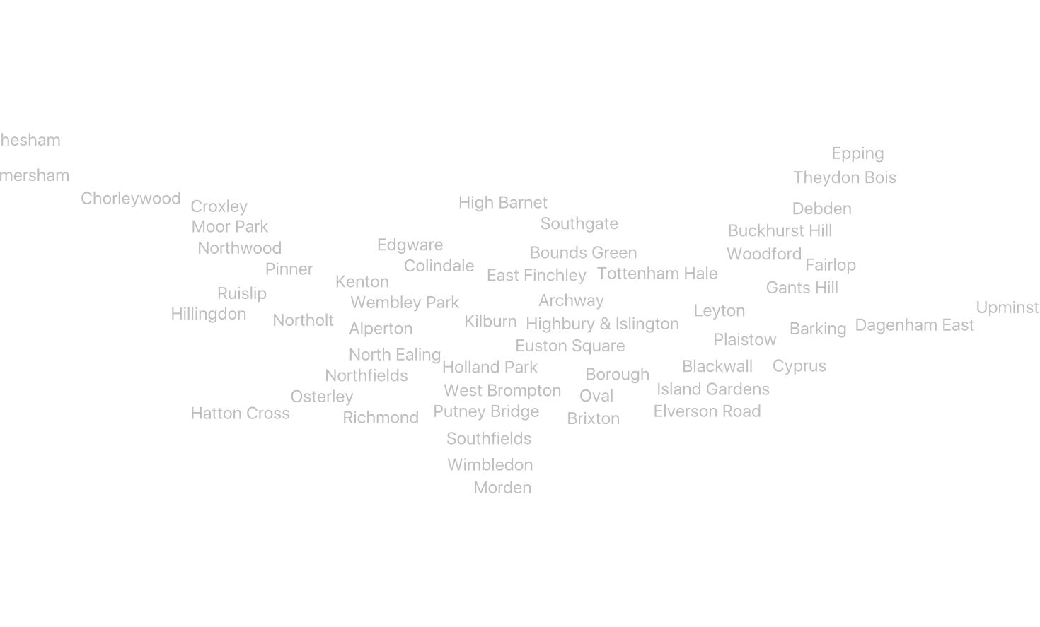
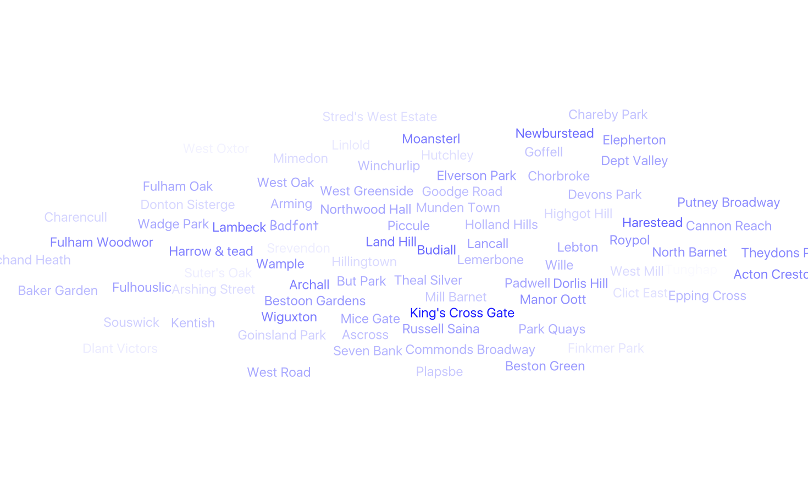
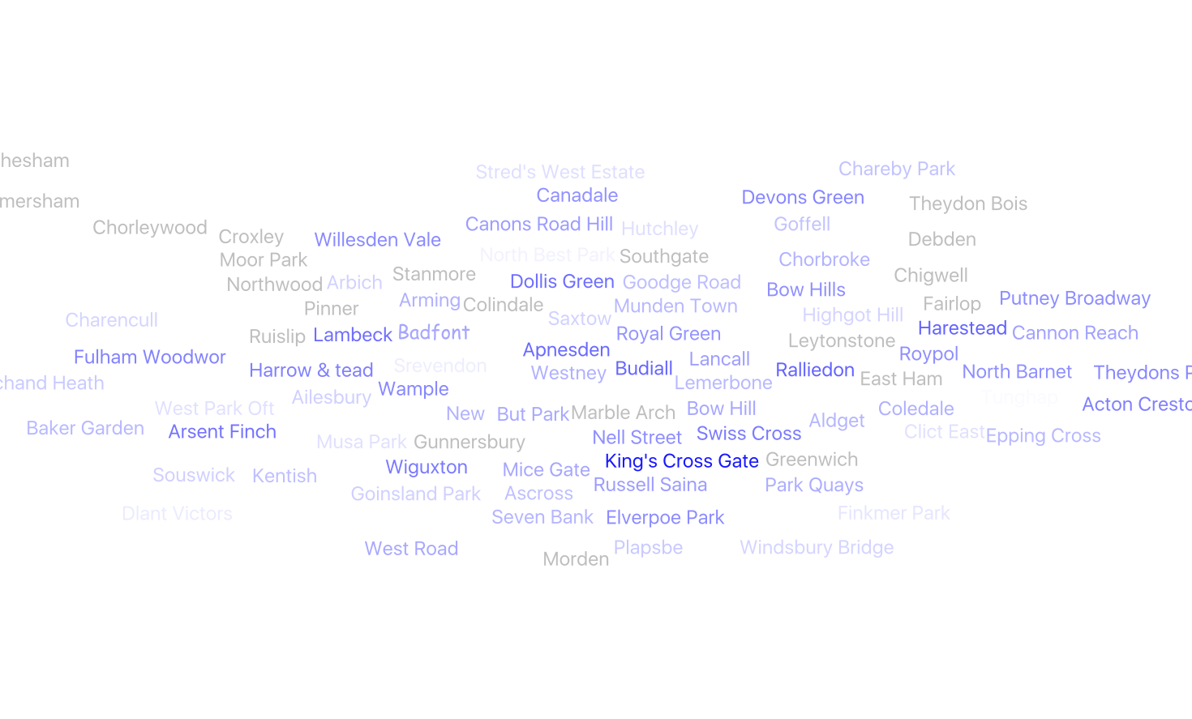
The Tube needs more stations

Slide 17
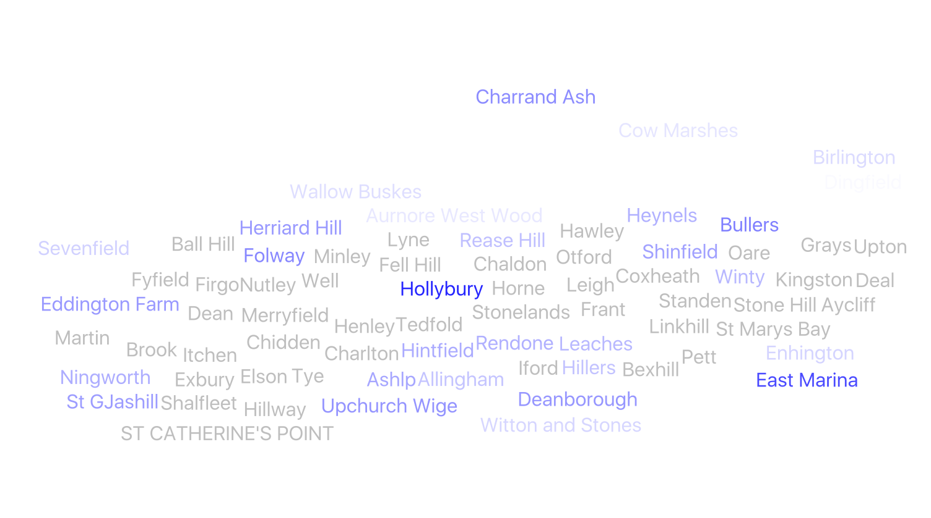
South East England

Slide 18
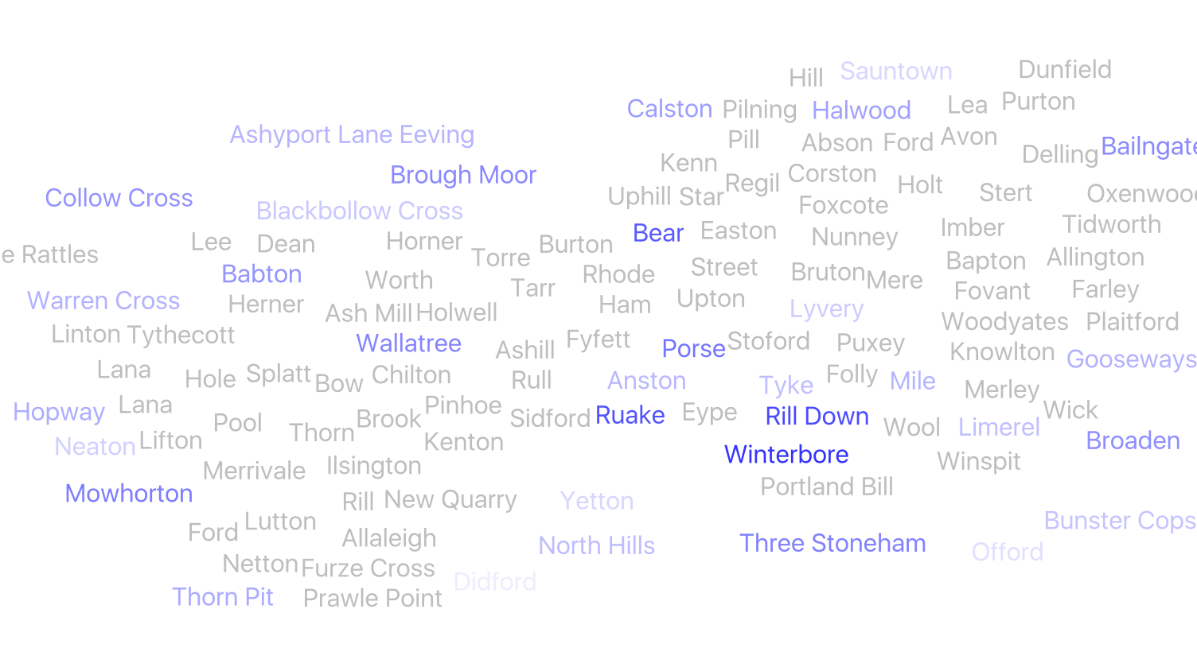
South West England

Slide 19
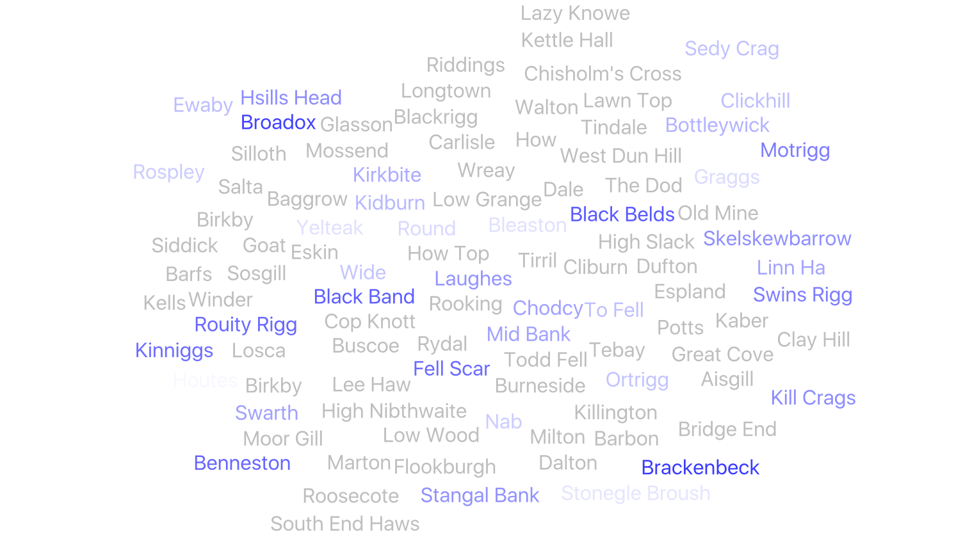
Cumbria

Slide 20
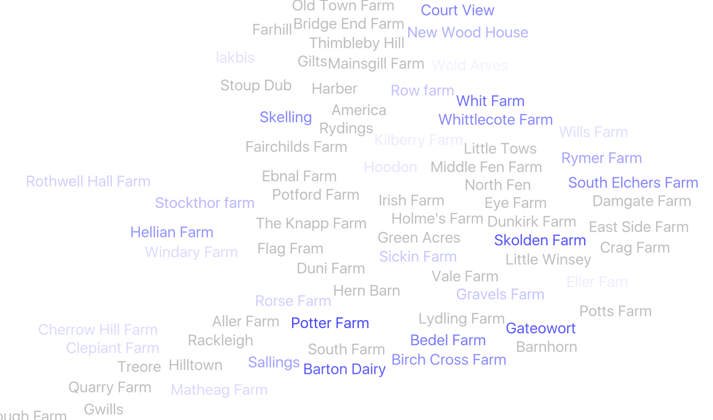
Farms

Slide 21
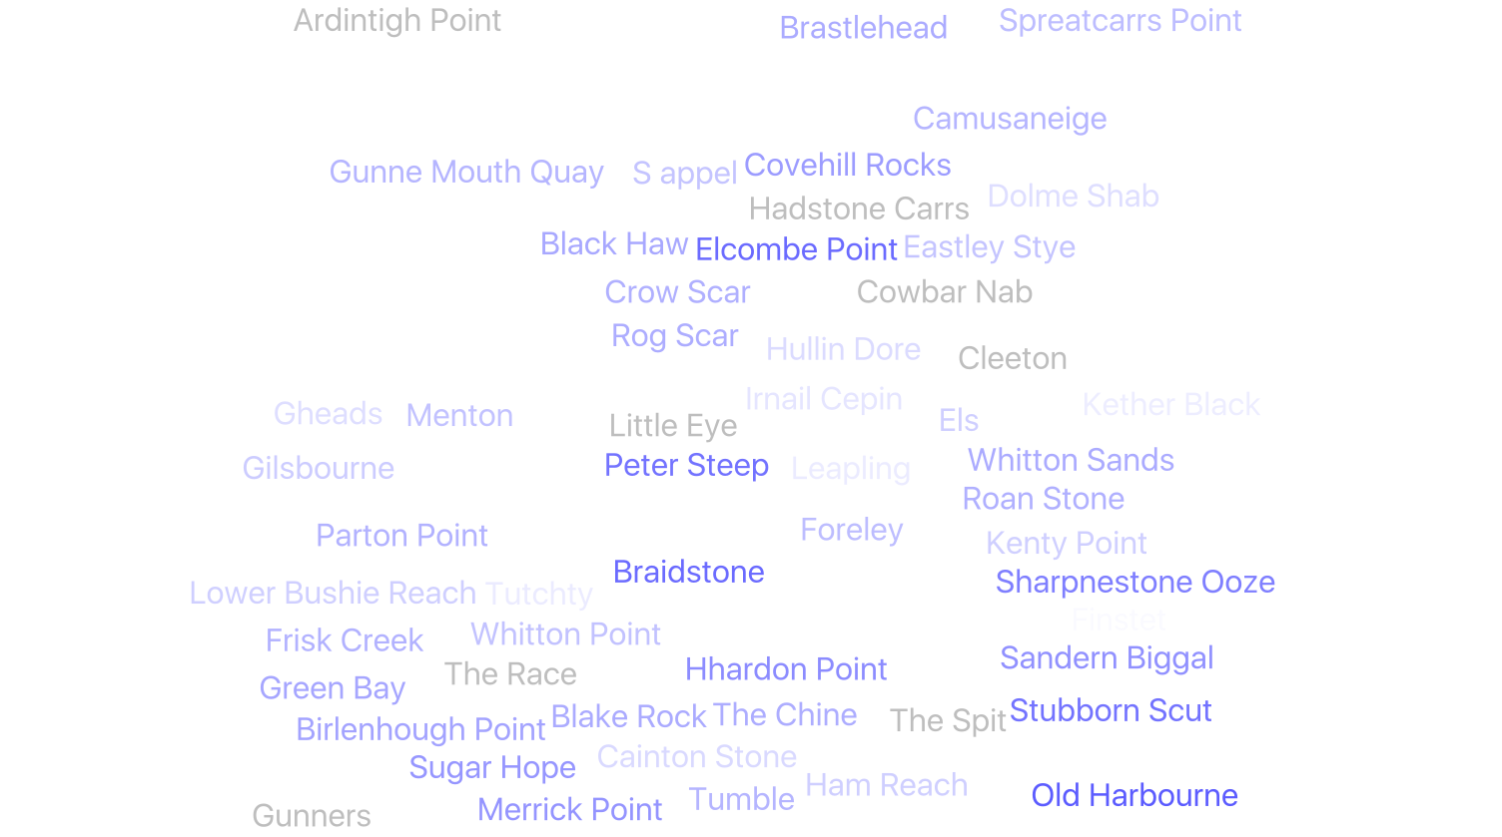
Maritime

Slide 22
Call My Bluff: London
Which of these are fake places?
Havering Grange
Havering-Atte-Bower
East Havering
Havering-Atdlewort
REAL
REAL
FAKE
FAKE

Slide 23
Call My Bluff: Greater Manchester
Which of these are fake places?
Wimboughton
Walmersley
Wybunbury
Wimbolds Trafford
FAKE
REAL
REAL
REAL

Slide 24
Call My Bluff: Southwest
Which of these are fake places?
Chedzoy
Middlezoy
Westonzoyland
Ogbourne Maizey
REAL
REAL
REAL
REAL

Slide 25
Call My Bluff: Southwest, fair version
Which of these are fake places?
Lockleaze
Charlton Fitzpaine
Lower Farleazo
Lydiard Tregoze
REAL
FAKE
FAKE
REAL

Slide 26
Call My Bluff: Southwest again
Which of these are fake places?
Windtworthy Zeal
Zeal Monachorum
Bozomzeal Cross
Winterborne Zealston
FAKE
REAL
REAL
REAL

Slide 27
Further research required
Whole country
Individual counties
JavaScript game
https://github.com/eldang/textgen-all-the-places

